Slide 1
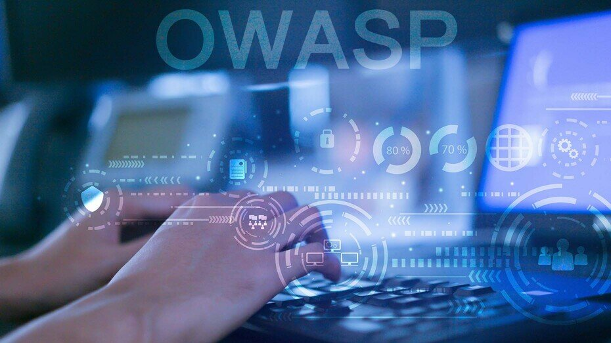
Secure Against the OWASP Top 10 for 2021 | Software and Data Integrity Failures (A8)
.
Afreen S Mohammed
March 18, 2022

Slide 2

A08:2021 Software and Data Integrity Failures
Description :
The new Software and Data Integrity Failures OWASP entry covers 10 CWEs, related to data and software integrity.
Software and data integrity failures occur:
The failure to comply with the software and data integrity which occur in the application that relies upon plugins, libraries, or modules from untrusted sources, repositories, and CDNs.
An insecure CI/CD pipeline could also allow unauthorized access, malicious code, or system compromise.
On failure to conduct integrity checks on software updates.Attackers could potentially upload their own updates to be distributed and run on all installations.

Slide 3
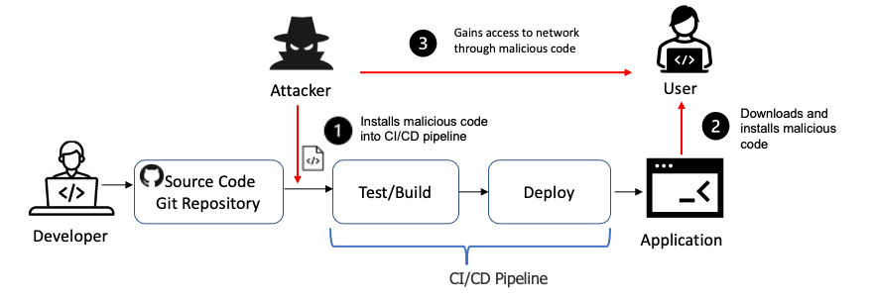
Software and Data Integrity Failures Attack Scenario
.
In the following scenario an attacker exploits an insecure CI/CD pipeline and installs malicious code to be distributed through the build and deploy process.
The attacker identifies an organizations' insecure CI/CD pipeline and installs malicious code that is pushed into production.
Customers unknowingly download the malicious code from the organizations update servers.
The malicious update is installed in the customer's environment.
The attacker uses the malicious code to gain access to the customer's network.

Slide 4


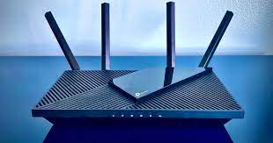
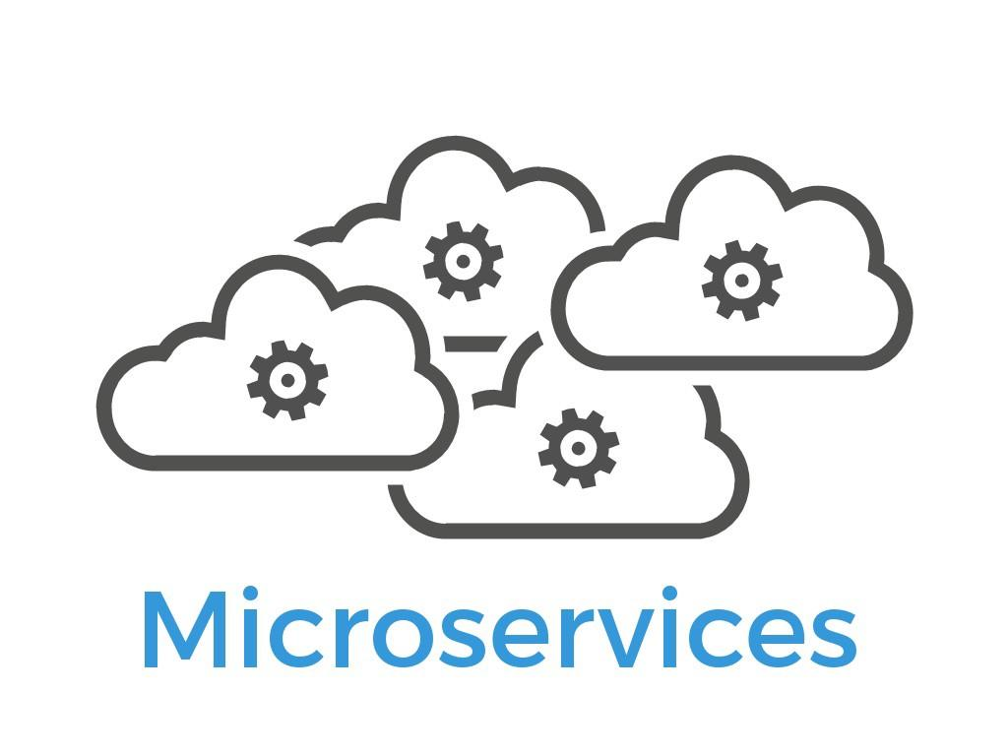
Attack Scenarios
Right click on gray block and click Replace image to insert your picture.
Right click on gray block and click Replace image to insert your picture.
Right click on gray block and click Replace image to insert your picture.
Scenario 1
Update without signing
Scenario 2
SolarWinds malicious update
Scenario 3
Insecure Deserialization

Slide 5
Software and Data Integrity Failures- Metrics
Topics |  | %
1. | CWE Mapped | 10
2. | Max Incidence Rate | 16.67%
3. | Avg Incidence Rate | 2.05%
4. | Max Coverage | 75.04%
5. | Avg Coverage | 45.35%
6. | Total Occurrences | 47,972

Slide 6

Secure against Software and Data Integrity Failures
Ensure that there is a review process for code and configuration changes to minimize the chance that malicious code or configuration could be introduced into your software pipeline.
1
Use digital signatures or similar mechanisms to verify the software or data is from the expected source and has not been altered.
Ensure libraries and dependencies, such as npm or Maven, are consuming trusted repositories.
4
Ensure that your CI/CD pipeline has proper segregation, configuration, and access control to ensure the integrity of the code flowing through the build and deploy processes.
2
5
Solutions
3
Ensure that a software supply chain security tool, such as OWASP Dependency-Check or OWASP CycloneDX, is used to verify that components do not contain known vulnerabilities.
6
Ensure that unsigned or unencrypted serialized data is not sent to untrusted clients without some form of integrity check or digital signature to detect tampering or replay of the serialized data

Slide 7
Thank You

